Slide 1
Error and Exception
Errors
Errors are events that a particular program can’t normally deal with. There are different types of errors, based on what's causing them - for example:
Syntax errors, where the compiler/interpreter cannot parse the written code into meaningful computer instructions;
User errors, where the software determines that the user’s input is not acceptable for some reason;
Programming errors, where the program contains no syntax errors, but does not produce the expected results. This are often called bugs.
Exceptions
Exceptions are events that are recognized (caught) by the program, categorized and handled. More specifically, there is a routine configured by the developer that is activated when an exception is caught. Sometimes, the handling mechanism can be simply stopping the execution.
Some of the exceptions are linked to the systems used, while others are linked to the logic of the business process.

Slide 2
Common Exceptions
Below you can find the most common exceptions that you can encounter in projects developed with UiPath. As a general note, all exceptions are types derived from System.Exception, so using this generic type in a Try Catch, for example, will catch all types of errors.
NullReferenceException - This error usually occurs when using a variable with no set value (not initialized).
IndexOutOfRangeException - Occurs when the index of an object is out of the limits of the collection.
ArgumentException - Is thrown when a method is invoked and at least one of the passed arguments does not meet the parameter specification of the called method.
SelectorNotFoundException - Is thrown when the robot is unable to find the designated selector for an activity in the target app within the TimeOut period.
ImageOperationException - Occurs when an image is not found within the TimeOut period.
TextNotFoundException - Occurs when the indicated text is not found within the TimeOut period.
ApplicationException - describes an error rooted in a technical issue, such as an application that is not responding.

Slide 3
Business Rule Exceptions
Business Rule Exceptions are separate from all the System Exceptions listed above. These describe errors rooted in the fact that certain data which the automation project depends on is incomplete, missing, outside of set boundaries (like trying to extract more from the ATM than the daily limit) or does not pass other data validation criteria (like an invoice amount containing letters).
The Business Rule Exceptions will not be thrown by using the generic System.Exception in a Try Catch activity. The mechanism of handling this exception has to be separately defined by the developer (based on the rules set by the process owner), or it can be reduced to stopping the execution of the process, by using a simple Throw activity, for example.

Slide 4
Try Catch
As a mechanism, Try Catch runs the activities in the Try block and, if an error takes place, executes the activities in the Catch block. The Finally block is only executed when no exceptions are thrown or when an exception is caught and handled in the Catch block (without being re-thrown).
Try
The activities performed which have a chance of throwing an error.
Catch
The activity or set of activities to be performed when an error occurs. Please note that multiple errors and corresponding activities can be added in this block.
Finally
The activity or set of activities to be performed after the Try Catch block. This section is executed only when no exceptions are thrown or when an error occurs and is caught in the Catch section.
Continue on error-Continue on Error is a property that specifies if the execution should continue even when the activity throws an error.

Slide 5
Retry Scope
The Retry scope activity retries the contained activities as long as the condition is not met, or an error is thrown.
The Retry Scope activity is used for catching and handling an error, which is why it’s similar to Try Catch. The difference is that this activity simply retries the execution instead of providing a more complex handling mechanism.
It can be used without a termination condition, in which case it will retry the activities until no exception occurs (or the provided number of attempts is exceeded).
Additional Properties
NumberOfRetries - The number of times that the sequence is to be retried.
RetryInterval - Specifies the amount of time (in seconds) between each retry

Slide 6
Global Exception Handler
The Global Exception Handler is a type of workflow designed to determine the behavior when encountering an execution error at the project level. This is why only one Global Exception Handler can be set per automation project
How does is work?
The Global Exception Handler has 2 predefined arguments, that shouldn't be removed:
errorInfo, with the In direction - contains the error that was thrown and the workflow that failed;
result, with the Out direction - will store the next behavior of the process when it encounters the error.

Slide 7
Practice 1 - Automation of Spreadsheet Calculation
Handle Exceptions in your client's Cash Flow
Your task is to automate the calculation of the difference between two fields in an Excel file (Cash In and Cash Out) and input it in the third column. Unfortunately, the file has accumulated a lot of errors over time. A simple workflow will throw System.Exception because the robot will try to perform math calculations with Int32 variables that contain letters.
Create a workflow that takes as input the excel file attached below and adds the difference between Cash In value and Cash Out value for each row on the third column. If the calculation of the difference between the two is successful, set the Status to Success, otherwise set it to either Cash In wrong or Cash Out wrong.
Use Try Catch blocks to catch exceptions when trying to convert Cash In and Cash Out values.

Slide 8
Practice 2 - Using the Global Exception Handler
Use the same workflow as for Practice 1 and use the Global Exception Handler to solve 2 issues by displaying the errors - a different sheet name or a different column name. This is a common type of error in real-life scenarios (wrong input).

Slide 9
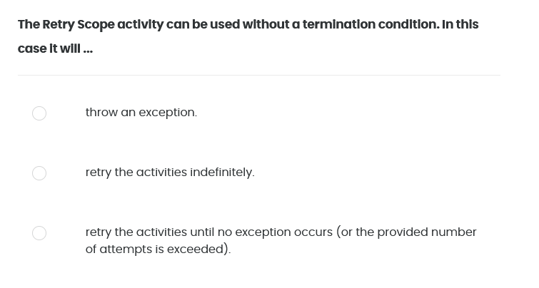
Quiz 01/07

Slide 10
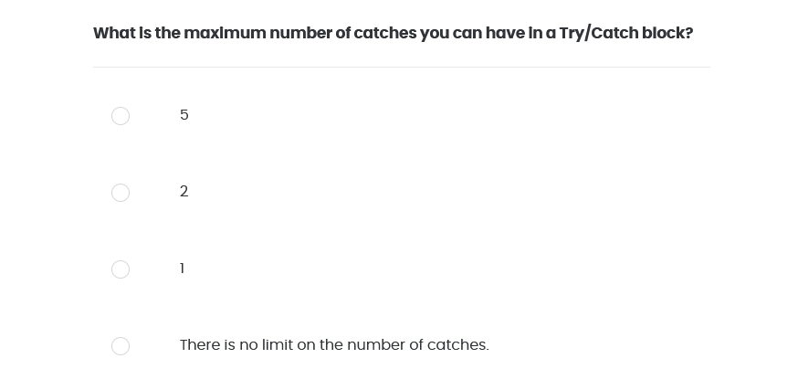
Quiz 02/07

Slide 11
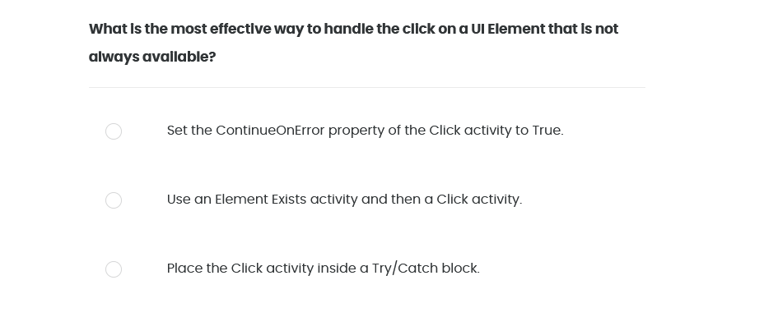
Quiz 03/07

Slide 12
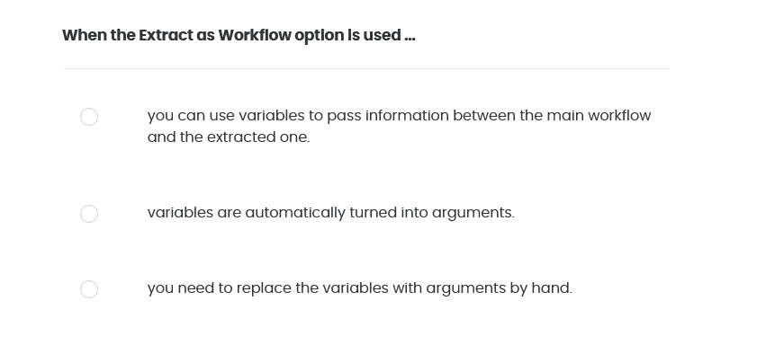
Quiz 04/07

Slide 13
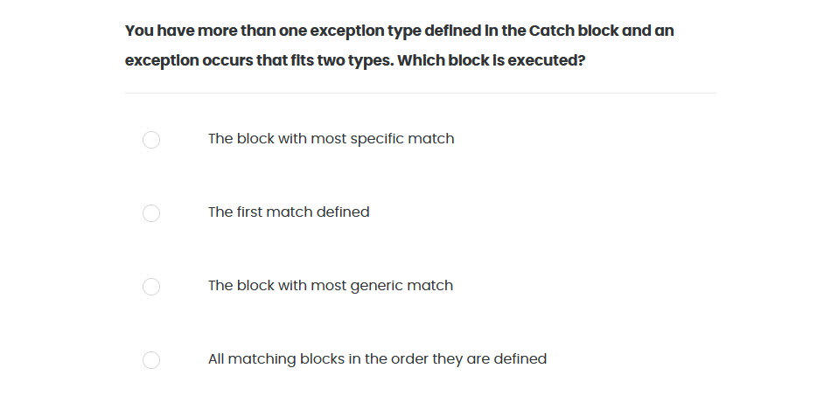
Quiz 05/07

Slide 14
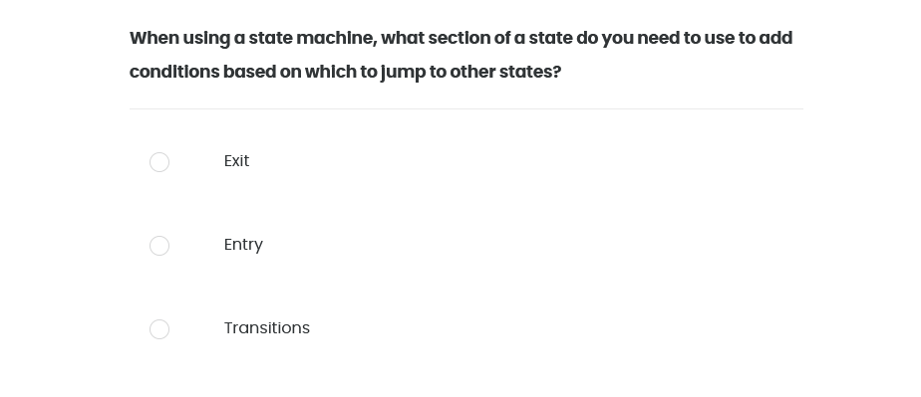
Quiz 06/07

Slide 15
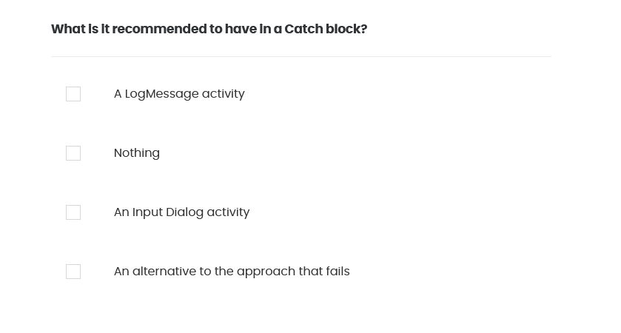
Quiz 07/07

